Slide 1
A Study Of
The Book Of Revelation
February 28, 2021

Slide 2

Revelation 13:16
Revelation 13
“And he causeth all, the small and the great, and the rich and the poor, and the free and the bond, that there be given them a mark on their right hand, or upon their forehead”

Slide 3
Revelation 13:17
Revelation 13
“and that no man should be able to buy or to sell, save he that hath the mark, (even) the name of the beast or the number of his name.”

Slide 4
Mark Of The Beast
Revelation 13
“Robert Mounce states that ‘religious tattooing was widespread in the ancient world, and devotees of a particular god were often branded to indicate their loyal devotion … Others take the passage as an apocalyptic description of certificates issued to those who had fulfilled the ceremonial obligations of emperor worship’”
(Robert Harkrider, Revelation, Truth Commentaries, Page 226)
Slaves and members of the Attis-Cybele cult were sometimes tattooed, and it has been conjectured that people in Ephesus were given an ink mark on the wrist or forehead that allowed them access to the market.
(Edwin Judge, The Mark Of The Beast, Revelation 13:16, Page 159)

Slide 5
Mark Of The Beast
Revelation 13
“In one such document the person requests certification that they had sacrificed to the gods and tasted sacred things. The certificate itself reads: ‘We, the representatives of the Emperor, Serenos and Hermas, have seen you sacrificing’” (Barclay, Letters, 29-30, quoted by Ferrell Jenkins, Studies in the Book of Revelation, Pages 27-28).
Others suggest this was coinage, which bore the emperor’s likeness long with divine titles. (Caird, Page 173)
Under Augustus people who received government grain, received a small tile (engraved?) which would grant them access to the granary. (Edwin Judge, The Mark Of The Beast, Revelation 13:16, Page 159)

Slide 6
Mark Of The Beast
Revelation 13
Was this a physical mark?
Remember, God has a seal (mark) upon those who belong to Him. (Revelation 7:3-4; 9:4; 14:1; 22:4).
2 Timothy 2:19, “Howbeit the firm foundation of God standeth, having this seal, The Lord knoweth them that are his: and, Let every one that nameth the name of the Lord depart from unrighteousness.”
Can indicate a moral and spiritual distinction.
  Exodus 13:9 Passover.
  Exodus 28:36-38 Priestly garments.
  2 Chronicles 26:19-20 Uzziah’s leprosy.

Slide 7
The Demands
Revelation 13
The totality of the human society was under threat of persecution if they did not receive the “mark.”
Whatever this mark was, it declared to those who saw it that the one who had the mark was loyal to the empire and emperor!
Those who worshipped the beast – belonged to the beast.
Unqualified allegiance to Christ required God’s saints to prefer suffering martyrdom over compromising their faith! (NOTE: Revelation 2:10, 13; 12:11)

Slide 8
The Demands
Revelation 13
The mark stands for the name of his beast and the number.
Those without the mark were prohibited from finding employment.
Lucrative positions were withheld from them.
They endured economic discrimination.
Why would one endure such hardships?
Why not find a way to appease the “god of this world” and still serve Christ?
Christians would not and could not compromise their faith and commitment to the Lord! (NOTE: Revelation 12:11)

Slide 9
Revelation 13:18
Revelation 13
“Here is wisdom. He that hath understanding, let him count the number of the beast; for it is the number of a man: and his number is Six hundred and sixty and six.”

Slide 10
The Number 666
Revelation 13
What is the meaning of the mystical number 666?
It has been assigned endless applications and to endless persons … Nero Caesar, the Catholic Pope, Napoleon, Martin Luther, John Calvin, Mussolini, Hitler, Saddam Hussein, or even the numbers used in the international trade system.
Note: Identifying the number 666 with any individual is a highly subjective exercise.
  Ray Summers, Worthy Is The Lamb, Page 176
  Robert Harkrider, Revelation, Truth Commentaries, Page 227
  William Hendriksen, More than Conquerors, Page 182
  L. David McClister, Overcoming With The Lamb, Florida College Lectures, 1994, Page 114
  Homer Hailey, Commentary on Revelation, Pages 297-299

Slide 11
The Number 666
Revelation 13
One of the most frequently used theories is one called gematria. This is where letters are given a numerical value. (Cryptographic method)
Gematria – “The use of the letters of a word so as by means of their combined numerical value to express a name, or a witty association of ideas.” (I.S.B.E., Vol. IV, Page 2162)
One of the earliest church writers to apply this method of interpretation was Irenaeus (AD 120-202), who offered three suggested names for the number:
  Euranthas, which seems to have no significance;
  Lateinos, from an early king of Latium, but not of Rome for “Latiyum at the present bear rule”;
  Teitan or Titan, a name which caution would be given to the Antichrist who was to come. But Irenaeus urged caution in accepting any of these. (Against Heresies, V. 30.3.A-N-F., I. Page 559). (Quoted by Hailey, Pages 297-298)

Slide 12
The Number 666
Revelation 13
“The general consensus among scholarly commentators is that the numbers refer to Nero Caesar. Kepler (148) says, ‘Some take the Latin word Neron and apply numerical equivalents for each letter in such fashion’”
    N – 50
    E – 6
    R – 500
    O – 60
    N – 50
  (From Ferrell Jenkins, Studies in the Book of Revelation, Page 26)
“The final N can be dropped, and the total would be 616. Others have transliterated the Greek or Latin for Neron Caesar into Hebrew letters and come up with a total 666. By omitting the final n in Neron the total comes to 616. There is a slight amount of evidence for the 616 reading. Irenaeus, before the end of the second century, was critical of manuscripts which had the number 616 (Against Heresies V, xxx.1)”

Slide 13
The Number 666
Revelation 13
What is not generally made known is that this solution asks us to calculate a Hebrew transliteration (given a defective spelling) of the Greek form of a Latin name.
The book of Revelation was written in Greek to a predominantly Gentile audience, so why should there be a shift to Hebrew to solve this riddle?
Are all of the numbers in Revelation to be understood symbolically or literally, and is there justification to alternate between the two? 144,000 (Revelation 7, 14); 1000-year reign (Revelation 20); 3½ days (Revelation 11:9); 3½ years; 42 months; 1,260 days … (Revelation 11:3; 12:6, 14; 13:5).

Slide 14
Numbers In The Book Of Revelation
Revelation 13
1 – Unity (Deuteronomy 6:14) One Jehovah God.
2 – Strength (Revelation 11:3)
3 – Divine number (see Matthew 28:19)
4 – Nature, Creation, World (Revelation 7:1)
5 – The whole man is represented by this number example (Revelation 17:10)
6 – Short of 7 – failure (Revelation 13:18)
7 – Completeness – perfection, totality, sometimes the combination
of 3 and 4
10 – Power – world power Number 5 multiplied twice.
Refer to Revelation 13:1. Ten horns.
1000 – Multiple of 10 X 10 X10. Whole or fullness
12 – Religious number.
3½ years; 42 months; 1,260 days … (Revelation 11:3; 12:6, 14; 13:5). Broken 7 – incomplete – indefinite period.

Slide 15
The Number 666
Revelation 13
Proper use of Numbers and Objects in Revelation.
“Understanding the symbolic meanings usually attached to numbers in this style of literature is necessary; numbers do not have real numerical value.
“We must discard our mathematical ideas and seek to discover their symbolical significance.
“A large part of the unscriptural dispensationalism of the day is based upon a false view of the value of numbers employed in Revelation.” (Robert Harkrider, Revelation – A Study Workbook, Page 5)

Slide 16
The Number 666
Revelation 13
The number 666 falls short of perfection …
It means that the combined forces of evil – dragon, Roman political power, and false religion – equal the number of “man” and “the beast”
Evil to the highest degree – will not win!
All who trust in man are destined to lose!
The fundamental difference between the lost and saved is the one in whom one places his trust – God or man?
This was true at this time – and it remains true in our time!

Slide 17
“Here Is Wisdom …” (cf. Matthew 6:24; 12:30)
Revelation 13
Read the Text!
Revelation 13:18, “Here is wisdom. He that hath understanding, let him count the number of the beast; for it is the number of a man: and his number is Six hundred and sixty and six.”
“psephizo (5585); from psephos (5586), a small stone or pebble used particularly by the Greeks and Egyptians in their calculations. To reckon, compute, calculate, figure out (Luke 14:28; Rev 13:18). In the classics also in the mid. meaning to give one’s vote, vote for, decree.” (from The Complete Word Study Dictionary)

Slide 18
“Here Is Wisdom …” (cf. Matthew 6:24; 12:30)
Revelation 13
Read the Text!
Revelation 13:18, “Here is wisdom. He that hath understanding, let him count the number of the beast; for it is the number of a man: and his number is Six hundred and sixty and six.”
Read the next verse …
Revelation 14:1, “And I saw, and behold, the Lamb standing on the mount Zion, and with him a hundred and forty and four thousand, having His name, and the name of His Father, written on their foreheads.”

Slide 19
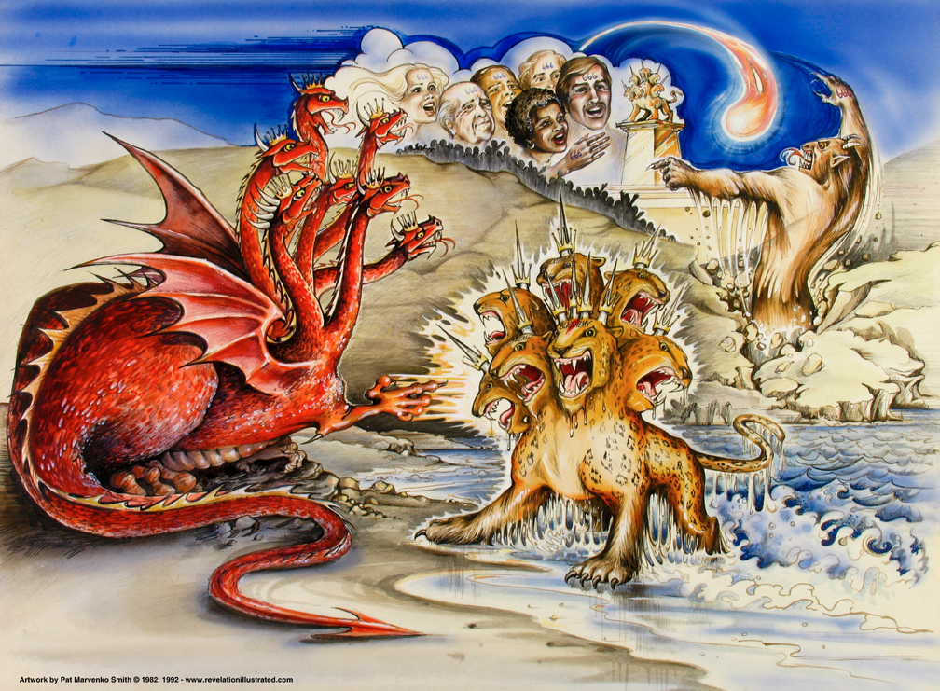
Revelation 13

